Slide 1
Data Science Essentials
Module: Data Science Essentials
Course: Higher Diploma in Software Engineering/Bachelor Degree in Software Engineering
Start Date : 27 Oct 2023
End Date : 21 Jan 2024
Submission Date : 21 Jan 2024
Learner Name : Syukur Sidiq Nur Alam
Enrollment ID : BDSE-0922-089
Presentation Date :

Slide 2
Contents
Document History
Version Number | Effective Date of release | Summary of Included Changes | Author
1 | 23rd April 2022 | First Edition

Slide 3
Contents
Contents
S. No. | Description
01 | Problem Statement
02 | Project Objectives
03 | Project Milestones & Tasks
04 | Data Analytics, BI and Data Science
05 | Data Types
06 | Select Data Analytics Tool
07 | Implementation Results: put evidence for each level and highlight problem with solution
08 | DAX functions if used (Optional)
09 | Milestone Feedback & Action
10 | Future Improvements

Slide 4
1. Problem Statement
HelloGreen, a company, is having trouble figuring out what causes staff attrition. The project manager, Mr. Lim, uses a data-driven strategy to find factors that impact workers and keep the best ones on board.

Slide 5
2. Project Objectives
The research aims to identify and analyze the elements that contribute to employee attrition.
- Create a data analytics dashboard-based corporate intelligence system.
- Assess how HelloGreen's problems can be addressed via data analytics.
- Evaluate the dashboard's usefulness in aiding in decision-making.

Slide 6
3. Project Milestones & Tasks
Project Task ID | Project Task Description | Project Milestone ID
1 | Project Initiation and Requirement Gathering | 1
2 | Data Analytics, BI and Data Science | 2
3 | Data Types | 3
4 | Data Analytics tools and techniques | 4
5 | Dashboard Development | 5
6 | Data Analytics | 6
7 | Evaluation | 7

Slide 7
4. Data Analytics, BI and Data Science
The science of examining unprocessed data to draw inferences about it is known as data analytics. A corporation may increase profitability, optimize performance, and make more strategically sound decisions with the use of data analytics.
Enterprises utilize business information analysis techniques and technological tools called business intelligence (BI) to turn business data into actionable insights that guide both tactical and strategic business decisions. BI technologies give users comprehensive information about the status of the business by gaining access to, analyzing, and presenting data sets and analytical results in reports, summaries, dashboards, graphs, charts, and maps.
The study of data to derive important business insights is known as data science. In order to evaluate vast volumes of data, data science is a multidisciplinary approach that blends ideas and methods from the domains of computer engineering, artificial intelligence, statistics, and mathematics.

Slide 8
5. Data Types
Structured data refers to information that has been organized in a systematic manner, typically within a formatted repository such as a database. This organization enables effective analysis of the data's elements, making it easier to retrieve, manage, and process.
Semi-structured data, on the other hand, doesn't reside in a traditional relational database but possesses some organizational properties that facilitate analysis. While it lacks the rigid structure of fully structured data, it still exhibits certain characteristics that make it more amenable to analysis than completely unstructured data.
Unstructured data, in contrast, is information that lacks a predefined structure or data model, rendering it unsuitable for conventional relational databases. This type of data doesn't adhere to a specific format, making it more challenging to analyze using traditional methods. Examples of unstructured data include text documents, images, audio files, and video clips.

Slide 9
6. Select Data Analytics Tool
In this instance, the author opted for the utilization of the Power BI tool due to its ability to seamlessly connect to diverse data sources. Power BI facilitates the visualization and exploration of crucial insights, empowering users to discern significant information. Furthermore, it provides a user-friendly platform for sharing these insights with specific individuals or a broader audience according to the user's preferences.

Slide 10
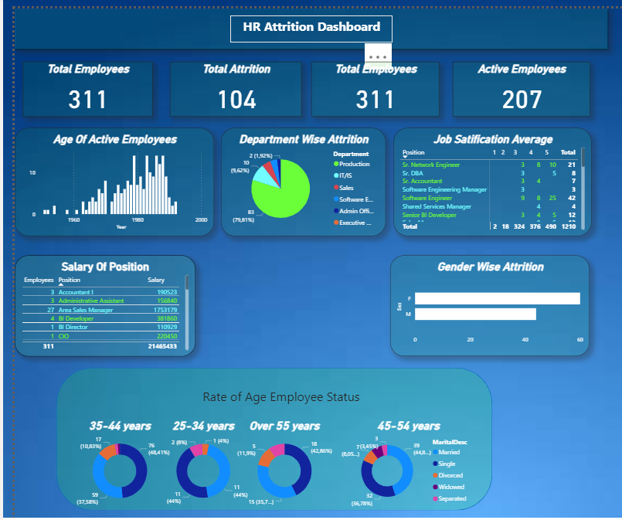
7. Implementation Results

Slide 11
8. DAX functions if used (Optional)

Slide 12
9. Milestone Feedback & Action

Slide 13
10. Future Improvements
Deeper Exploration of Power BI Features
Integrate Advanced Analytics
Enhanced Interactivity and Dashboard Features
Enhanced Collaboration and Sharing:

Slide 14
THANK YOU

